Slide 1
ENTREPRENEURSHIP
Lecture No: 27
Resource Person:
Malik Jawad Saboor
Assistant Professor
Department of Management Sciences
COMSATS Institute of Information Technology
Islamabad.

Slide 2
Influencing and Negotiation

Slide 3
Influencing
Management is about getting things done, meeting objectives set in line with those of organisation, to get the things done management is influencing or imposing their will upon others, people may or may not be willing but they need to work towards a common goal, there cud be two extremes ‘ carrot or stick’ but there are many options in between, lets have a look on some influencing strategies

Slide 4
Influencing Strategies
Reason
Friendship
Coalition
Higher Authority
Sanctions

Slide 5
Negotiations
‘Negotiation is a process in which individual or groups seek to reach a goal by making agreements with others’
‘Negotiation is a dialogue intended to resolve disputes, to produce an agreement upon courses of action to bargain for individual and collective advantage’

Slide 6
Negotiation is the trading of value
Common Ground
The value to you and your organisation
The value to the other and their organisation
What is it that I have to offer them?
What is it that I want from them?
What is it that they need from me?
What is it that they have to offer me?

Slide 7

Negotiation Strategies
Hard Bargaining
Soft Bargaining
Principled Bargaining

Slide 8
Hard Bargaining
Gives away nothing.
See participant as adversaries
Hard sell and take-it-or-leave-it.
Distrust others
Play sneaky games to get negotiating advantage
May use physical presence/threats
Two hard bargainers may end up both loosing

Slide 9
Soft Bargaining
Agreeable & Flexible.
Treating the participant as friends
Seeking agreement at any cost
Honest about their bottom line
Leaves them to vulnerable to hard bargainers

Slide 10
Principled Bargaining
Separate the people from the problem
Focus on interests, not positions.
Generate options for mutual gain.

Slide 11

Types of negotiation
Distributive (win-lose)
Integrative (win-win)

Slide 12

Planning to negotiate
Establish your objectives
Map other party’s objectives
Frame negotiation as a joint search for a solution
Identify areas of agreement
Trouble shoot disagreements: bargain & seek alternative solutions, introduce trade offs
Agreement and close: summarise and ensure acceptance

Slide 13

Team Roles in Negotiating Team
Lead Negotiator
Number Cruncher
Note Taker
Time Keeper

Slide 14

Factors for success
Legitimacy of your case
Confidence in presenting it
Courtesy to the other party
Adaptation to the other party’s style
Rapport
Incentives and trade offs
Research the bigger picture

Slide 15
Tips on Negotiation
Aim high to begin with – easier to lose ground than gain
Give concessions ‘reluctantly’
Break down complex deals
Language:
Make proposals with open questions such as:
“what would happen if we…?”
“suppose we were to…”
“what would be the result of?”
Dealing with stone-walls: “what would need to happen for you to be willing to negotiate over this?”
Always get agreement in writing

Slide 16
What is a Social Enterprise?
According to the Social Enterprise Coalition, Social Enterprises are…
“…businesses trading for social and environmental purposes. Social enterprises are distinctive because their social and/or environmental purpose is absolutely central to what they do - their profits are reinvested to sustain and further their mission for positive change.”
Notes:
Essentially, Social Enterprises are commercial businesses, designed to make profit. The difference occurs with the profit, which is reinvested to meet the social aims of the business.
There are many descriptions of Social Enterprises.
It is important to understand that a Social Enterprise is not a legal structure

Slide 17
What is a Social Enterprise?
“We have described and keep on describing organisations motivated by social objectives as non-profit organisations. We need to have another
description: ‘non-loss ’organisations, because we don’t want to lose money and our objective is to address a particular problem. So we are non-loss businesses with social objectives.”
Muhammad Yunus. Founder of the Grameen Bank, Bangladesh

Slide 18
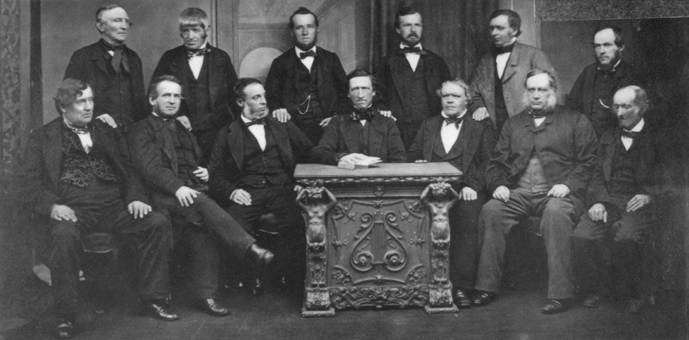
Example of Social Enterprise
The Social Enterprise movement first emerged 1840s. In Rochdale, a workers' co-operative was set up to provide high quality affordable food in response to factory conditions that were considered to be exploitative.
The Rochdale Society of Equitable Pioneers est 1844
Notes:
It is a misconception that Social Enterprise is a relatively new idea. Many long-established organisations qualify as Social Enterprises.
Social Enterprise has been frequently found in the financial sector, including Mutuals and Friendly Societies.
The Cooperative movement can be considered to be a major player in the field of Social Enterprise after providing benefits to members for many years.

Slide 19
The Process of Social Entrepreneurship
Find an opportunity
Develop a business concept
Figure out what success means and how to measure it
Acquire the right resources
Launch and grow
Attain goals

Slide 20
Characteristics
Social Enterprises:-
Operate as commercially run businesses
Aim to make profits
Generate the bulk of their income through sales of goods or
services
Use good business practices and principles
Use the majority of their profits to further social or
environmental goals
May hold the Social Enterprise Mark
Notes:
In February 2010 the Social Enterprise Mark was launched as the brand for social enterprises. It requires a business to meet six defined criteria in order to qualify to receive the Mark.
Many commercial businesses would consider themselves to have social objectives. Whether these objectives are central to the organisation determines whether they are indeed a social enterprise or a business with Social Aims

Slide 21
Key Differences
Explicit Social Aims (Triple Bottom Line) | Private sector business primarily focus is on trading; social enterprises too have a commercial focus but will also have an explicit social and/or environmental purpose.
Funding | Social enterprises often have a complex composition of sales income, commercial contracts, service level agreements and grant support.
Risk | Social enterprises are usually governed by a Board of volunteers, which may mean that they are more risk averse in terms of pursuing business ventures.
Scale | Start up costs may be much higher because social enterprise usually has to operate on a scale that is large enough to sustain its social commitment from the beginning
Notes:
There are a number of significant differences between social enterprises and private enterprises, in both the way that they are developed and the way in which they continue to develop

Slide 22
Key Differences
Investment | Social enterprises may have difficulty gaining access to traditional forms of investment such as loan finance.
Leadership / Entrepreneurship | Leaders of social enterprises are usually driven by the social potential of the venture and will need to find support for the other areas of the enterprise
Stakeholders | Social Enterprises usually have a wide range of stakeholders involved in their development, which can mean that there is a wide influence on the development process.

Slide 23


Lecture Review
Identify the key attributes of a Social Enterprise
Characteristics of Social Enterprise
Understand how social enterprise differ from other organisations
Entrepreneurs in Action- Video on Google Boys

